Slide 1
Lab 5
Computer Network Lab
Lab Demonstrator Kabeer Ahmed

Slide 2
Topic Included:
Previous Lab
Installation Window Client Server
Domain User Creation
Current Lab
Internet Protocol IP
IP Classes
Subnetting and CIDR

Slide 3
Internet Protocol IP
An IP (Internet protocol ) address is a unique identifier for a node or host connection on an IP network.
An IP Address is a 32 bit binary number, usually represented as 4 decimal values, each representing 8 bits, in the range 0 to 255 (known as Octets) separated by decimal points. This is known as dotted notation
Example: 140.179.220.200

Slide 4
Binary Representation
It is sometime useful to view the values in their binary form
A Class C Address
140 | 179 | 220 | 200
1000 1100 | 1011 0011 | 1101 1100 | 1100 1000
192 | 168 | 13 | 55
11000000 | 10101000 | 00001101 | 00110111

Slide 5
Class and Subnet Mask
Every IP address consist of two parts, one identifying the node and other identify Network
The Class of the Address
Subnet mask
determine which part belong to network and which part belong to node address.

Slide 6
Network Address
The network address uniquely identifies each network. Every machine on the same network shares that network address as a part of its IP address. In the IP address 130.57.30.56, for example , the 130.57 is the network address.
>Ipconfig /all command is used to check the IP address

Slide 7
Node Address
The node address is assigned to, and uniquely identifies , each machine on a network.
This number can also be referred to as a host address. In the sample IP address 130.57.30.56 the .30.56 is the node address.

Slide 8
Address Classes
The designer of the internet decided to create classes of network based on network size.
For the small number of networks possessing a very large number of nodes, they created rank Class A network.
At the other extreme is Class C network, reserved for the numerous networks with a small number of nodes

Slide 9
The class distinction for networks in between very large and very small is predictably called a Class B network. How one would subdivide an IP address into a network and node address is determined by the class designation of one’s network.

Slide 10
Type of Class Addresses
There are 5 different address classes. You can determine which class an IP address is in by examining the first 4 bits of IP address.
Class Name | Address begin with | Decimal notation
Class A | 0xxx | 1---126
Class B | 10xx | 128---191
Class C | 110x | 192---223
Class D | 1110 | 224---239
Class E | 1111 | 240---254

Slide 11
Loopback Address
Addresses beginning with 0111 1111 or 127 decimal , are reserved for loopback and for internal testing on a local machine.
[You can test this. You should always be able to ping 127.0.0.1, which points to your self. ]

Slide 12
Reserved Address
Class D addresses are reserved for multicasting.
In computer networking, multicast is the delivery of a message or information to a group of destination computers simultaneously in a single transmission from the source creating copies automatically in other network elements, such as routers, only when the topology of the network requires it.
Class E addresses are reserved for future use. They should not be used for host address

Slide 13
Class | Leftmost Bits | Start Address | Finish Address
A | 0xxx | 0.0.0.0 | 127.255.255.255
B | 10xx | 128.0.0.0 | 191.255.255.255
C | 110x | 192.0.0.0 | 223.255.255.255
D | 1110 | 224.0.0.0 | 239.255.255.255
E | 1111 | 240.0.0.0 | 255.255.255.255

Slide 14
Now we can see how the class determines, by default, which part of IP address belongs to the Network(N) and which part belongs to the Node(n).
Class | Address
Class A | NNNNNNNN . nnnnnnnn . nnnnnnnn . nnnnnnnn
Class B | NNNNNNNN . NNNNNNNN . nnnnnnnn . nnnnnnnn
Class C | NNNNNNNN . NNNNNNNN . NNNNNNNN . nnnnnnnn

Slide 15
Example
In the example 140.179.220.200 is a Class B address. So by default the
Network part of the address (also known as Network Address) is defined by the first two octets (140.179.xxx.xxx) and
Node part is defined by the last 2 octets (xxx.xxx.220.200).

Slide 16
In order to specify the network address for a given IP address , the node section is set to all “0”’s.
In our example, 140.179.0.0 specifies the network address for 140.179.220.200.

Slide 17
When the node section is set to all “1”’s it specifies a broad cast that is sent to all hosts on the network.
140.179.255.255 specifies the example broadcast address . Note that this is true regardless of the length of the node section.

Slide 18
Class | Format | Leading Bit Pattern | Decimal Range of First Byte Of the Network Address | Maximum Networks | Maximum Nodes Per Network
A | Net.Node.Node.Node | 0 | 1 --- 127 | 127 (2^{n-1}) | 16,777,214 (2^{n}-2)
B | Net.Net.Node.Node | 10 | 128---191 | 16384 (2^{n-2}) | 65,534 (2^{n}-2)
C | Net.Net.Net.Node | 110 | 192 --- 223 | 2097152 (2^{n-3}) | 254 (2^{n}-2)

Slide 19
Reserved IP Address
Address | Description
Network Address to all 1’s | Interpreted to mean all networks
Network 127 | Reserved for loopback tests. Designates the local node and allows that to send a test Packet to itself without generating network traffic.
Node Address of all 1’s | Interpreted to mean ‘all nodes’ on the specified network, for example, 128.255.255.255 means ‘all nodes on the network 128.255.255.255’ (Class B Address).
Entire IP address set to all 0’s | Used by the RIP Protocol to designate the default route.
Entire IP address set to all 1’s | Broadcast to all nodes on the current network, (same as 255.255.255.255) sometimes called an all 1’s broadcast
Notes:
Routing Information Protocol (RIP) is a distance-vector routing protocol, which employs the hop count as a routing metric.

Slide 20
Subnetting
Subnetting an IP Network can be done for a variety of reasons, Including organizations, use of different Physical media
(Such as
Ethernet,
FDDI,
WAN,
etc).
Preservation of address space and security.
The most common reason is to control network traffic.

Slide 21
Subnetting
In an Ethernet network, all nodes o a segment see all packets transmitted by all the other nodes on that segment.
Performance can be adversely affected under heavy traffic loads, due to collision and the resulting retransmission.
A router is used to connect IP networks to minimize the amount of traffic each segment must receive.

Slide 22
Subnet Masking
Applying a subnet mask to an IP address allows you to identify the network and the node parts of the address.
The network bits are represented by the 1’s in the mask, and the node bits are represented by the 0’s.
Performing a bitwise logical AND operation between the IP Address and the subnet mask results in the network address or Number.

Slide 23
For example , using our test IP and the default Class B subnet mask we get Class B Address.
Network Address: 140.179.000.000
 | 1st octet | 2nd octet | 3rd octet | 4th octet
 | 1000 1100. | 1011 0011. | 1111 0000 | 1100 1000
AND | 1111 1111. | 1111 1111. | 0000 0000. | 0000 0000
Result | 1000 1100. | 1011 0011. | 0000 0000. | 0000 0000

Slide 24
Class | 1st Octet | 2nd Octet | 3rd Octet | 4th Octet
Class A | 255 | 0 | 0 | 0
 | 1111 1111 | 0000 0000 | 0000 0000 | 0000 0000
Class B | 255 | 255 | 0 | 0
 | 1111 1111 | 1111 1111 | 0000 0000 | 0000 0000
Class C | 255 | 255 | 255 | 0
 | 1111 1111 | 1111 1111 | 1111 1111 | 0000 0000

Slide 25
Private Network
The governing bodies that administer the network Protocol have identified certain networks as reserved for internet use.
In general , intranet that use these networks can reduce the difficulty in administering their IP configuration and Internet access.
These are networks, along with their default masks as listed in next slide

Slide 26
Network Address | Network Mask
10.0.0.0 | 255.0.0.0
172.16.0.0 | 255.240.0.0
192.168.0.0 | 255.255.0.0

Slide 27
CIDR
Short for Class Inter Domain Routing as IP addressing scheme that replaces the older system based on classes A, B and C with CIDR a single IP address can be used to designate many unique IP address.
A CIDR IP address looks like a normal IP address except that it ends with a slash “/” followed by a number called the IP network Prefix.

Slide 28
Example
172.200.0.0/16
The IP network prefix specifies how many addresses are covered by CIDR address, with lower numbers covering more addresses. An IP network of /23 , for example can be used to address 1048576 former Class C address
CIDR address reduces the size of routing table and make more IP address available within organizations.
CIDR is also called “Super Netting”

Slide 29
Under CIDR, the subnet mask notation is reduced to a simplified shorthand. Instead of spelling out the bits of the subnet mask, it is simply listed as the number of 1’s bits that start the mask.

Slide 30
In the above example. Instead of writing the address and subnet mask as 192.60.128.0 , Subnet mask 255.255.252.0 the network address would be written simply as:
192.60.128.0/22 which indicates starting address of network, and number of 1’s bits (22) in the network portion of the address.

Slide 31
If you look at the subnet mask in binary
1111 1111 . 1111 1111. 1111 1100. 0000 0000
You can easily see how this notation works.
The use of a CIDR notation address is the same as for a class full address . Class full addresses can easily be written in CIDR.

Slide 32
Class | CIDR Notation
Class A | /8
Class B | /16
Class C | /24

Slide 33
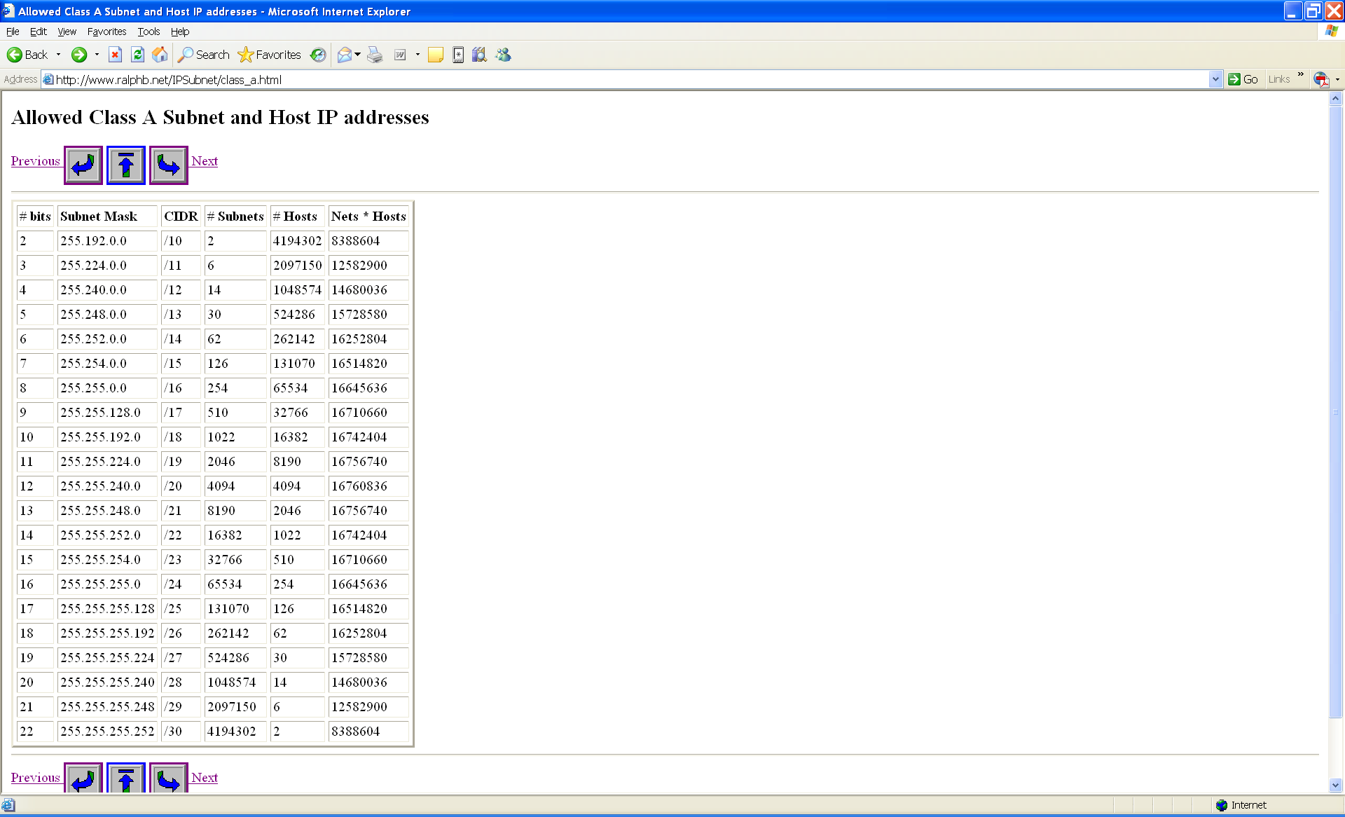
Class A Subnetting Options

Slide 34
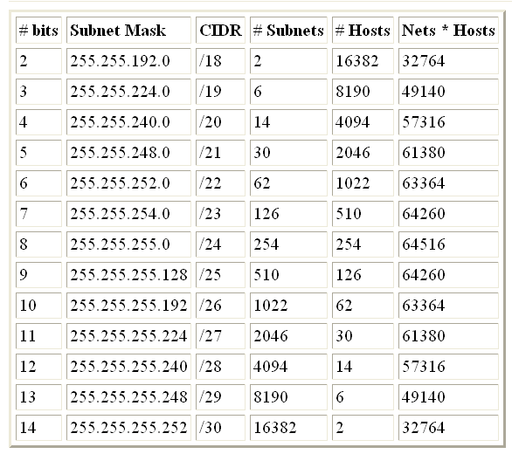
Class B Subnetting Options

Slide 35
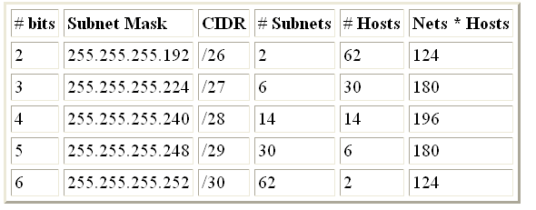
Class C Subnetting Options

Slide 36
Scaling Subnets
With a requirement of 23 nodes…
The next perfect power of 2 that meets this need = 32
2⁵ = 32 5 host bits needed
Last Octet is then represented as:
A.B.C.NNNHHHHH N=Network H=Host
11111111.11111111.11111111.11100000

Slide 37
Subnetting Examples
SubnetMask SubnetMask # Hosts
255.255.255.0 /24 256 (254)
255.255.255.128 /25 128 (126)
255.255.255.192 /26 64 (62)
255.255.255.224 /27 32 (30)
255.255.255.240 /28 16 (14)
255.255.255.248 /29 8 (6)
255.255.255.252 /30 4 (2)

Slide 38
Problem!
The 192.168.20.0 /24 network gives us:
1 Network
254 Nodes Available for Assignment
13 Subnetworks Required
Network Demands range from 4 – 32 nodes per LAN / WAN segment

Slide 39
Start Subnetting

Slide 40
Subnetting

Slide 41
Subnetting

Slide 42
Box Diagram Alternate

Slide 43
Address Range

